Slide 1
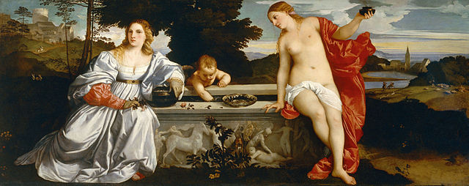
History 336
Tutorial 1
Scott, “Gender: A Useful Category of Historical Analysis”

Slide 2
Monday, 14 January
At 9:30, Rebecca Dowson, the History liaison librarian, will give us a 30-minute presentation on how to use e-books at the SFU library. Bring your laptop / iPad / iPod or any other relevant device. You will probably find e-books very useful in History 336.

Slide 3
The structure of Scott’s article
a discussion of the term gender (pp. 1053-56)
a review of theories about gender (pp. 1056-66)
Scott’s development of her own understanding of gender (pp. 1066-70)
the application of gender as a category of analysis to political history (pp. 1070-75)

Slide 4
Two important passages
“How does gender work in human social relationships? How does gender give meaning to the organization and perception of historical knowledge? The answers depend on gender as an analytic category” (p. 1055).
“Indeed, the challenge was to reconcile theory, which was framed in general or universal terms, and history, which was committed to the study of contextual specificity and fundamental change” (p. 1057).

Slide 5
7 Questions
How have scholars understood the term “gender”? What are the various advantages to using this term? Does the term come with disadvantages?
How does Scott define gender? What are the various components of her definition?
Scott reviews different theoretical perspectives of gender as a category of analysis. What are these perspectives? What advantages might they have? What weaknesses do they have? What deficiency do they have in common?
How does Scott apply gender as a category of analysis to political history?

Slide 6
7 Questions
What have you learned from reading Scott’s article? Did it provide you with new ways of thinking about gender and history? Did it confirm or challenge ideas that you already had?
Can you apply Scott’s thinking to Chapter 1 of Wiesner-Hanks’s book?
Can you apply Scott’s thinking to historical periods or themes that you have studied in other courses?

